Slide 1
Blockchains: Hyperledger
Introduction
bparente@fit.edu
2021

Slide 2
Permissionless vs Permissioned Blockchains
With permissionless blockchains like the Bitcoin blockchain or the Ethereum blockchain, anyone can join the network, as well as write and read transactions.
The actors in the system are not known, which means there could be some malicious actors within the network.
Permissioned blockchains restrict membership to only approved entities and thereby reduce these security risks.
They can also limit visibility of transactions to only to the parties involved or other defined subsets of the membership population.
Both permissioned and permissionless may have smart contract capabilities.

Slide 3
Hyperledger
Hyperledger is one of the more high-profile blockchain efforts.
It contains several blockchain projects most of which use a permissioned blockchain by default.
The Hyperledger Project began when a set of companies who were starting to pay attention to the Bitcoin, cryptocurrency, and blockchain space approached The Linux Foundation and planned a joint project within the Foundation.

Slide 4
Hyperledger
In December of 2015, The Linux Foundation, in conjunction with about 30 companies including IBM, Intel, and JP Morgan, announced the launch of the Hyperledger project.
Its first release of software was in February of 2016 with the Fabric codebase.
Initially it had been built inside of IBM, but was contributed to be part of the open-source Hyperledger project.
It was followed soon after by Sawtooth Lake from Intel.
Currently, over 250 organizations support Hyperledger

Slide 5
Hyperledger
Hyperledger is a growing group of open source projects facilitating cross-industry distributed ledger technologies. Its focus is to support collaborative blockchain development.
It is hosted by The Linux Foundation and includes collaborators from technology, finance, banking, supply chain management, manufacturing, IoT, and other industries.
Hyperledger now consists of 16 projects including 6 blockchain frameworks, as well as several tools and libraries that can be used with these frameworks.

Slide 6
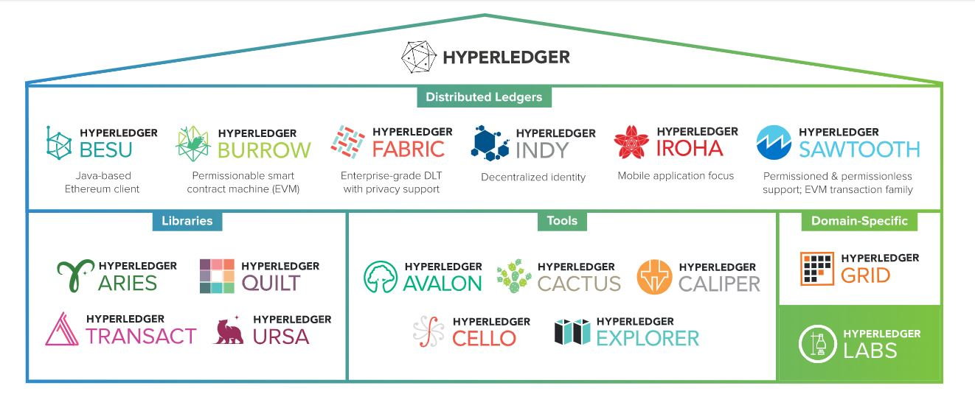
HYPERLEDGER MODULAR UMBRELLA APPROACH

Slide 7
Hyperledger
Hyperledger provides an alternative to the cryptocurrency-based blockchain model, and focuses on developing blockchain frameworks and modules to support global enterprise solutions.
Many of the features are geared towards permissioned blockchain applications that involve partial trust.

Slide 8
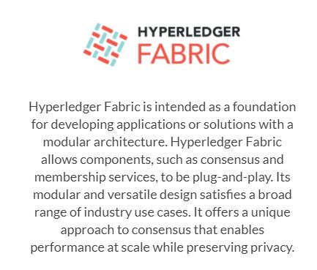
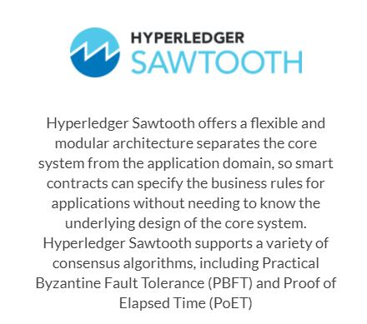
Hyperledger Frameworks
https://www.hyperledger.org/use/distributed-ledgers

Slide 9
Fabric
Fabric is Hyperledger’s most active project to date. The Fabric 1.0 release was issued in July 2017, and the latest releases as of mid-April 2021 are 2.3.1 (Feb 3, 2021) and 1.4.11 (Mar 2, 2021) (https://github.com/hyperledger/fabric/releases).
IBM initiated the Fabric project. It’s intended as a foundation for developing blockchain distributed ledger applications with a modular architecture. It allows components, such as consensus and membership services, to be plug-and-play.
The core of the platform is written in the Go programming language, as are the applications that run on it.
A unique characteristic of Fabric is that its distributed ledger and smart contract platform allows for private channels.
If you want to share data with only certain blockchain participants, you can create a private channel with just those participants.

Slide 10
Sawtooth
The Sawtooth project originally came from Intel. It includes a novel consensus algorithm called Proof of Elapsed Time (PoET).
The Sawtooth consensus software targets large distributed validator populations with minimal resource consumption.
It is designed to work with very broad and flat networks of hundreds to thousands of nodes without having the CPU burden of cryptocurrencies’ validation methods like Proof of Work.
Hyperledger Sawtooth offers an SDK to abstract away many of the complicated aspects of blockchain technology.
SDKs are available in multiple languages, including Java, Python, and Javascript.

Slide 11
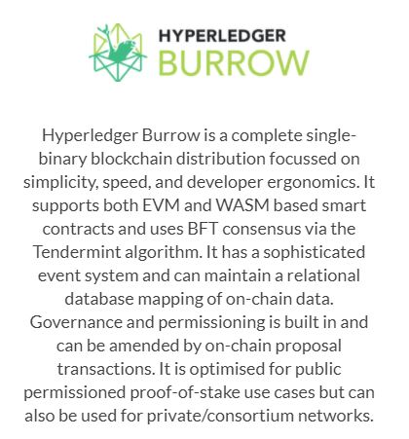
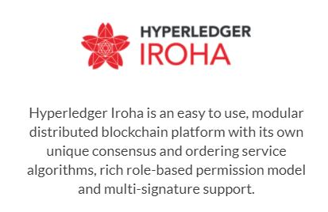
Hyperledger Frameworks
https://www.hyperledger.org/use/distributed-ledgers

Slide 12
Burrow
Burrow is a blockchain node and smart contract execution engine -- a distributed database that executes code.
Burrow runs Ethereum Virtual Machine (EVM) and Web Assembly (WASM) smart contracts. (many languages can compile to WASM)
Burrow networks are synchronized using the Tendermint consensus algorithm.(https://arxiv.org/pdf/1807.04938.pdf)
Burrow supports permissioned networks that are, in some sense ‘open to the public.’ There are many potential variations; validators may be established on an invite-only basis, or Burrow could be configured much like permissionless public Ethereum.
Burrow targets modes of operation that bridge the gap between private chains and public permissionless ones.

Slide 13
Iroha
Hyperledger Iroha is a blockchain framework contributed by Soramitsu, Hitachi, NTT Data, and Colu.
It is designed to be simple and easy to incorporate into infrastructure projects requiring distributed ledger technology.
It emphasizes mobile application development with client libraries for Android and iOS, making it distinct from other Hyperledger frameworks.
Inspired by Hyperledger Fabric, Hyperledger Iroha seeks to complement Hyperledger Fabric and Hyperledger Sawtooth, while providing a development environment for C++ developers to contribute to Hyperledger.
Iroha features a simple construction, modern, domain-driven C++ design, along with the consensus algorithm YAC (Yet Another Consensus algorithm).

Slide 14
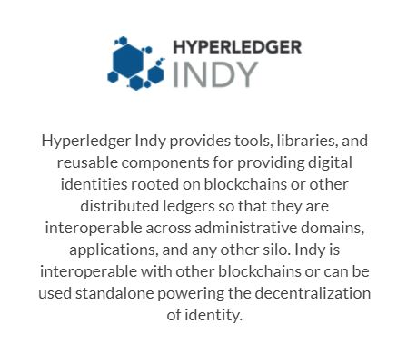
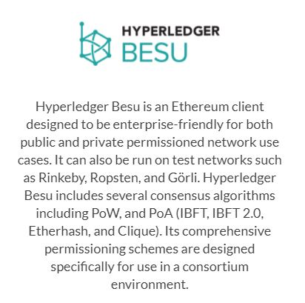
Hyperledger Frameworks (cont’d)
https://www.hyperledger.org/use/distributed-ledgers

Slide 15
Indy
The Indy project was originally the brainchild of the nonprofit group the Sorvin Foundation.
The idea is to provide digital identities for individuals and give them the power to share their identity with whom they chose.
Not only does it give the individual control over that information, it benefits companies in that they don’t have to store so much personal data, which is a potential liability (e.g. Experian and other hacks).
Instead, they can store a pointer to the identity.

Slide 16
Besu
Besu is the most recent of the Hyperledger frameworks. It is a Java-based Ethereum client that can operate on a public blockchain as well as a permissioned network.
Besu is designed to be as modular as possible, with a separation of concerns between consensus algorithms and other key blockchain features, making these components easy to upgrade or implement.
Besu implements the Enterprise Ethereum Alliance (EEA) specification.
The EEA specification was established to create common interfaces amongst the various open and closed source projects within Ethereum, to ensure users do not have vendor lock-in, and to create standard interfaces for teams building applications.

Slide 17
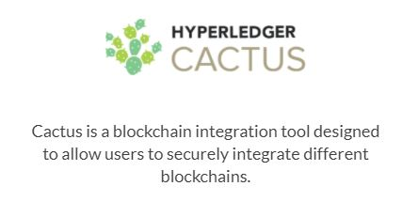
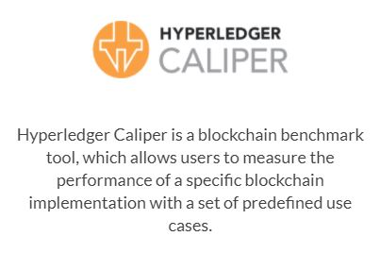
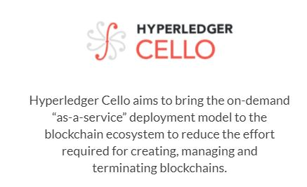
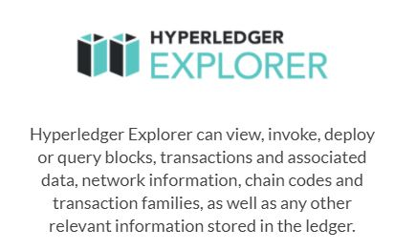
Hyperledger Tools
https://www.hyperledger.org/use/tools

Slide 18
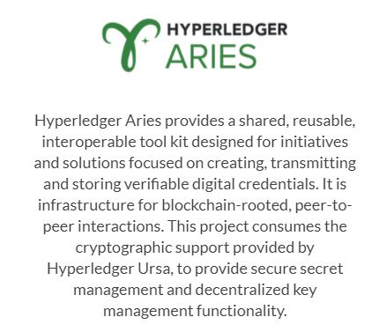
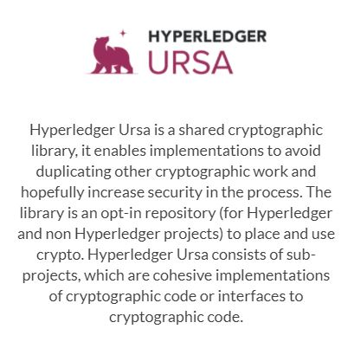
Hyperledger Libraries
https://www.hyperledger.org/use/libraries

Slide 19
Architecture Overview
All Hyperledger projects follow a design philosophy that includes a modular extensible approach, interoperability, an emphasis on highly secure solutions, a token-agnostic approach with no native cryptocurrency, and the development of a rich and easy-to-use Application Programming Interface (API).
The Hyperledger Architecture WG has distinguished the following business blockchain components:
Consensus Layer - Responsible for generating an agreement on the order and confirming the correctness of the set of transactions that constitute a block.
Smart Contract Layer - Responsible for processing transaction requests and determining if transactions are valid by executing business logic.
Communication Layer - Responsible for peer-to-peer message transport between the nodes that participate in a shared ledger instance.
Data Store Abstraction - Allows different data-stores to be used by other modules. LevelDB is the default, and CouchDB is another built-in option.

Slide 20
Architecture Overview Blockchain components (cont’d)
Crypto Abstraction - Allows different crypto algorithms or modules to be swapped out without affecting other modules.
Identity Services - Enables the establishment of a root of trust during setup of a blockchain instance, the enrollment and registration of identities or system entities during network operation, and the management of changes like drops, adds, and revocations. Also, provides authentication and authorization.
Policy Services - Responsible for policy management of various policies specified in the system, such as the endorsement policy, consensus policy, or group management policy. It interfaces and depends on other modules to enforce the various policies.
APIs - Enables clients and applications to interface to blockchains.
Interoperation - Supports the interoperation between different blockchain instances.

Slide 21
Consensus
Consensus must provide the following core functionality:
Confirms the correctness of all transactions in a proposed block, according to endorsement and consensus policies.
Agrees on order and correctness and hence on results of execution (implies agreement on global state).
Interfaces and depends on smart-contract layer, if applicable, to verify correctness of an ordered set of transactions in a block.
The operating assumption for Hyperledger developers is that business blockchain networks will operate in an environment of partial trust.
Given this, standard PoW consensus approaches with anonymous miners are purposely not included, as these approaches impose too great a cost in terms of resources and time to be optimal for business blockchain networks.
Many PoS methods are also not applicable given partial trust.

Slide 22
Comparison of Consensus Types
Alternatives to PoW and PoS algorithms that may be more applicable to partial trust blockchains such as Hyperledger include lottery and voting-based methods.
Each of these approaches targets different network requirements and fault tolerance models.
The lottery-based algorithms are advantageous in that they can scale to a large number of nodes since the winner of the lottery proposes a block and transmits it to the rest of the network for validation.
On the other hand, these algorithms may lead to forking when two “winners” propose a block.
Each fork must be resolved, which results in a longer time to finality.

Slide 23
Consensus Algorithms
The voting-based algorithms are advantageous in that they provide low-latency finality; no potential forking to be resolved.
When a majority of nodes validates a transaction or block, consensus exists and finality occurs.
Because voting-based algorithms typically require nodes to transfer messages to each of the other nodes on the network, the more nodes that exist on the network, the more time it takes to reach consensus.
This results in a trade-off between scalability and speed.

Slide 24
Consensus in Hyperledger Sawtooth
Hyperledger Sawtooth facilitates pluggable consensus for both lottery and voting algorithms.
By default, Hyperledger Sawtooth uses a lottery-based consensus algorithm called PoET.
PoET uses a lottery for leader election based on a guaranteed wait time provided through a Trusted Execution Environment (TEE)
The current implementation of Hyperledger Sawtooth builds on a TEE provided by Intel’s Software Guard Extensions (SGX). (https://software.intel.com/en-us/sgx)
This ensures the safety and randomness of the leader election process without requiring the costly investment of power and specialized hardware inherent in most “proof” algorithms.
Every PoET validator requests a random time to wait from a trusted function before claiming leadership. The validator with the shortest wait time for a particular transaction block is implicitly elected the leader.
https://sawtooth.hyperledger.org/docs/core/releases/latest/architecture/poet.html

Slide 25
Sawtooth and PoET
The PoET leader election algorithm meets the criteria for a good lottery algorithm.
It randomly distributes leadership election across the entire population of validators with a distribution that is similar to what is provided by other lottery algorithms.
The probability of election is proportional to the resources contributed, where resources are general purpose processors with a TEE.
An attestation of execution provides information for verifying that the certificate was created within the TEE and that the validator waited the allotted time.
Further, the low cost of participation increases the likelihood that the population of validators will be large, increasing the robustness of the consensus algorithm.

Slide 26
Hyperledger Fabric Model
Key Design Features:
Assets - Asset definitions enable the exchange of almost anything with monetary value over the network, from whole foods to antique cars to currency futures.
Chaincode - Chaincode execution is partitioned from transaction ordering, limiting the required levels of trust and verification across node types, and optimizing network scalability and performance.
Ledger Features - The immutable, shared ledger encodes the entire transaction history for each channel, and includes SQL-like query capability for efficient auditing and dispute resolution.
Privacy through Channels - Channels enable multi-lateral transactions with the high degrees of privacy and confidentiality required by competing businesses and regulated industries that exchange assets on a common network.
Security & Membership Services - Permissioned membership provides a trusted blockchain network, where participants know that all transactions can be detected and traced by authorized regulators and auditors.
Consensus - a unique approach to consensus enables the flexibility and scalability needed for the enterprise.
http://hyperledger-fabric.readthedocs.io/en/release/fabric_model.html

Slide 27
Assets
Assets can range from the tangible (real estate and hardware) to the intangible (contracts and intellectual property), with a user-defined set of properties.
Hyperledger Fabric provides the ability to modify assets using chaincode transactions.
Assets are represented in Hyperledger Fabric as a collection of key-value pairs, with state changes recorded as transactions on a Channel ledger.
Assets can be represented in binary and/or JSON form.
You can easily define and use assets in your Hyperledger Fabric applications using the Hyperledger Composer tool.

Slide 28
Chaincode
Chaincode is software defining an asset or assets, and the transaction instructions for modifying the asset(s); it’s the business logic, or the smart contract.
Chaincode enforces the rules for reading or altering key value pairs or other state database information.
Chaincode functions execute against the ledger’s current state database and are initiated through a transaction proposal.
Chaincode execution results in a set of key value writes (write set) that can be submitted to the network and applied to the ledger on all peers.

Slide 29
The Ledger, Transactions
The ledger is the sequenced, tamper-resistant record of all state transitions in the fabric; the blockchain.
State transitions are a result of chaincode transactions submitted by participating parties.
Transactions consist of the versions of keys/values that were read in chaincode (read set) and keys/values that were written in chaincode (write set).
Transactions contain signatures of every endorsing peer and are submitted to ordering service.
Transactions are ordered into blocks and are “delivered” from an ordering service to peers on a channel.

Slide 30
Ledger Features
So the ledger is comprised of a blockchain to store the immutable, sequenced record in blocks, as well as a state database to maintain current fabric state.
There is one ledger per channel.
Each peer maintains a copy of the ledger for each channel of which they are a member.
The ledger supports
Blockchain explorer functions
Query and update using key-based lookups, range queries, and composite key queries
Read-only queries using a rich query language (if using CouchDB as state database)

Slide 31
Privacy through Channels
Hyperledger Fabric employs an immutable ledger and associated chaincode on a per-channel basis.
A ledger exists in the scope of a channel - it can be shared across the entire network (assuming every participant is operating on one common channel) - or it can be privatized to only include a specific set of participants.
And within a channel access can be more finely grained as chaincode functions can be selectively installed.
To further obfuscate the data, values within chaincode can be encrypted (in part or in total) using common cryptographic algorithms such as AES before appending to the ledger.

Slide 32
Security and Membership Services
Hyperledger Fabric underpins a transactional network where all participants have known identities.
Public Key Infrastructure is used to generate cryptographic certificates which are tied to organizations, network components, and end users or client applications.
As a result, data access control can be manipulated and governed on the broader network and on channel levels.
This “permissioned” notion of Hyperledger Fabric, coupled with the existence and capabilities of channels, helps address scenarios where privacy and confidentiality are paramount concerns.

